Slide 1


A Low-Cost, Off-the-Shelf
Prototyping Platform for
Molecular Communications Research

Slide 2
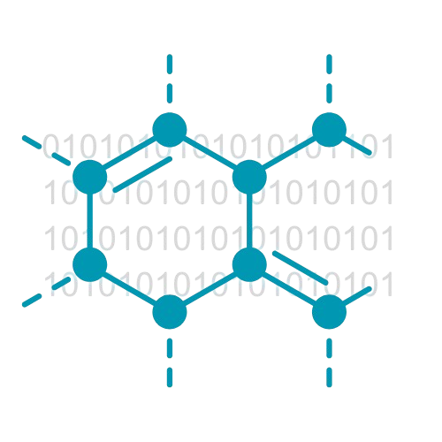
01
Introduction

Slide 3

Communication is essential for the sustainability of society.
Electromagnetic (EM) waves are the dominant medium in modern communication systems.
Some environments are unsuitable for EM wave communication.
Increasing focus on alternative communication technologies.
Molecular communication (MC) has gained significant attention from researchers.

Slide 4
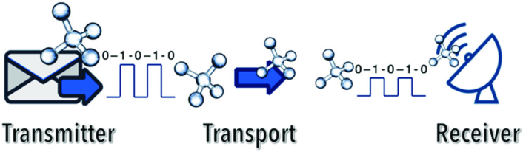
Molecular Communication (MC) ?
MC mimics biological systems for data transfer.
Inspired by natural processes like cell signaling.
It uses molecules as carriers to send information.
Transmitters release molecules to carry data signals.
Receivers detect and decode these molecules.

Slide 5
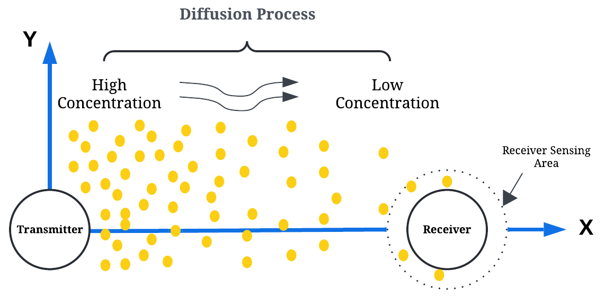
MC Classification
Channel Type
Propagation Mechanism
Modulation Techniques
Wired Communication
Diffusion-based
Concentration-based
Wireless Communication
Flow-based
Type-based
Active transport-based
Timing-based
Spatial modulation

Slide 6
02
Research Problem

Slide 7
Building MC channels requires specialized hardware and chemicals.
Hardware used is bulky and requires careful handling.
Expertise in embedded systems development is essential for handling hardware and chemicals in MC.
This complexity makes it difficult for communication and network researchers to work with MC for data communication.
Ready-to-use research hardware platforms are necessary for rapid prototyping and experimentation at a lower cost.

Slide 8
03
Related Work

Slide 9
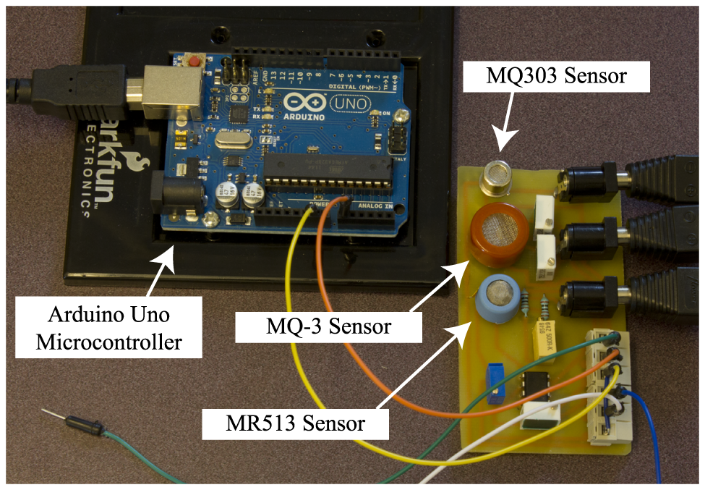
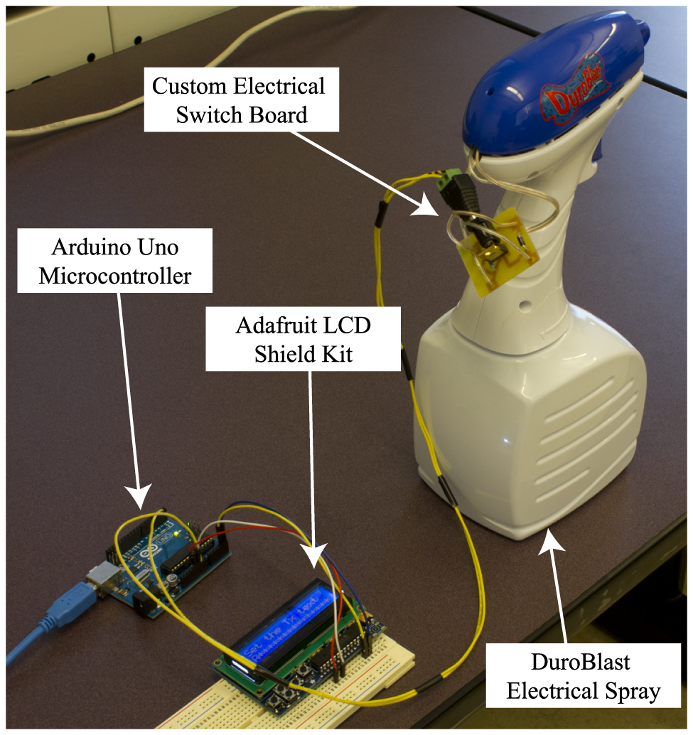
Most studies are conducted in controlled environments using tubes or cylinders to connect the sender and receiver.
A macroscopic (cm to m) MC system for transmitting a brief text message using isopropyl alcohol chemical signals (Farsad et al.).
Transmitter - an Arduino Uno with an LCD and push buttons for text input, converts the text into a binary sequence using the ITA2 standard, and modulates it into chemical signals for transmission via an electronic spray.
Receiver - an Arduino Uno to process signals from sensors (MQ-3, MQ303A, and MR513), converting them into text.
Receiver
Transmitter

Slide 10
03
Aims & Objectives

Slide 11
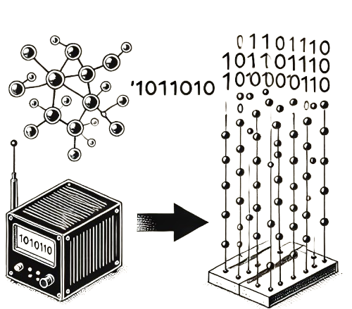
Exploring the possibilities of establishing MC between two computers using a wireless diffusion mechanism using low-cost, off-the-shelf
hardware components.
✔ Free diffusion -
No guided flow between sender and receiver
✔ Near real-world scenario -
At room temperature
✔ Low-cost, off-the-shelf hardware

Slide 12
04
Experiments & Results

Slide 13
High-Level Approach
Literature
Review
MC Platform Implementation
Experimentation & Testing
Selection of Sensors and Chemicals

Slide 14
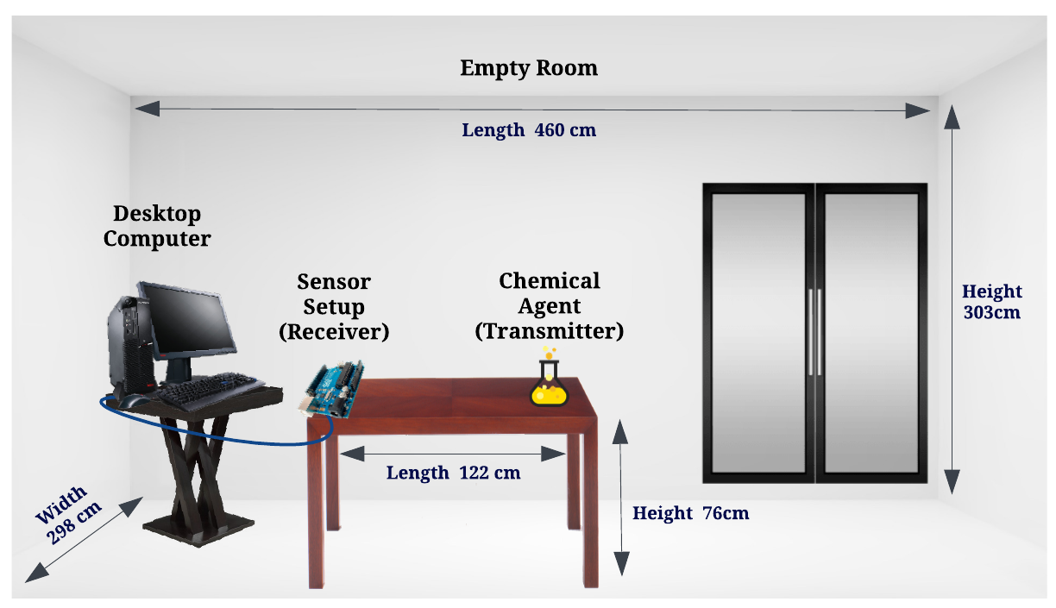
Overall Experimental Setup
Ethanol/ Thinner

Slide 15
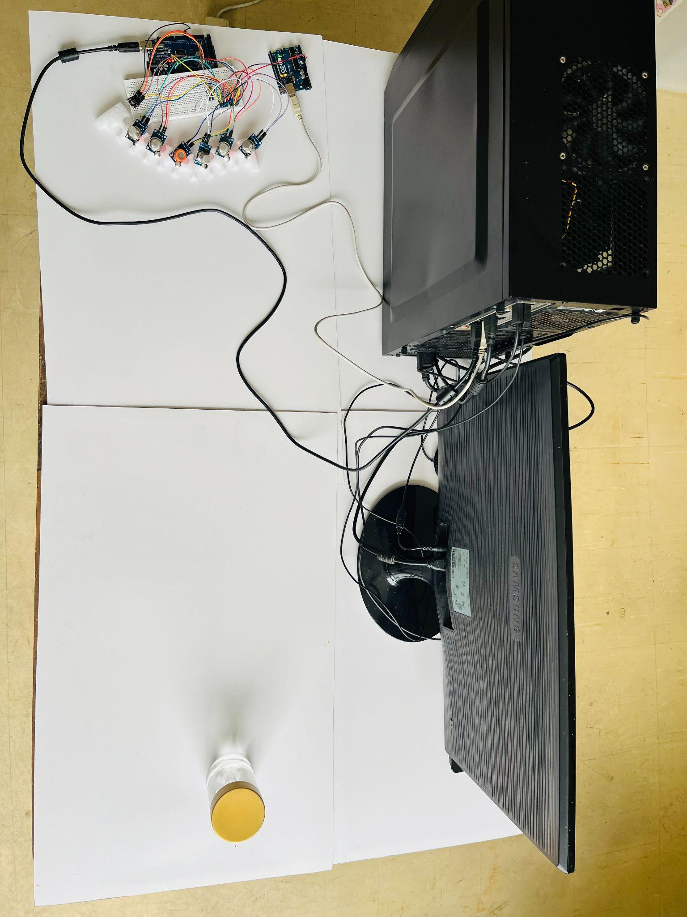
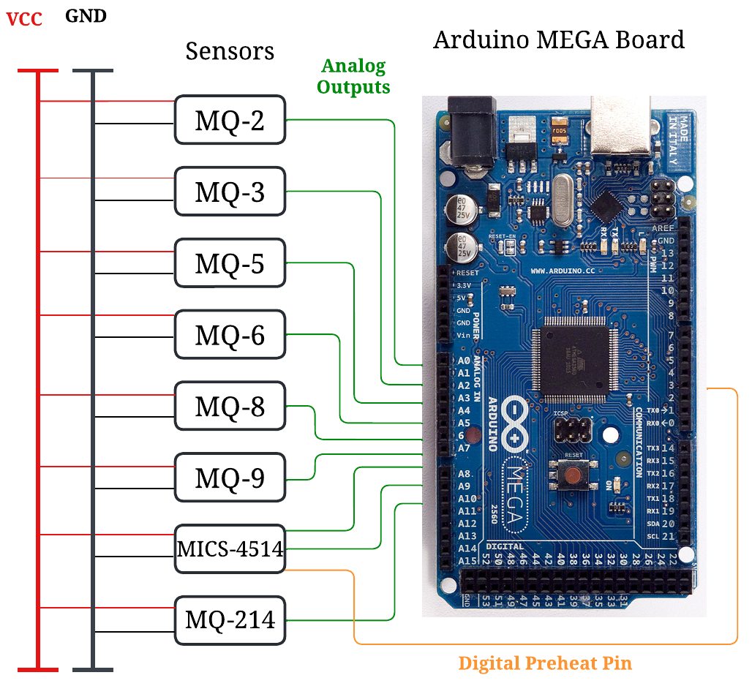
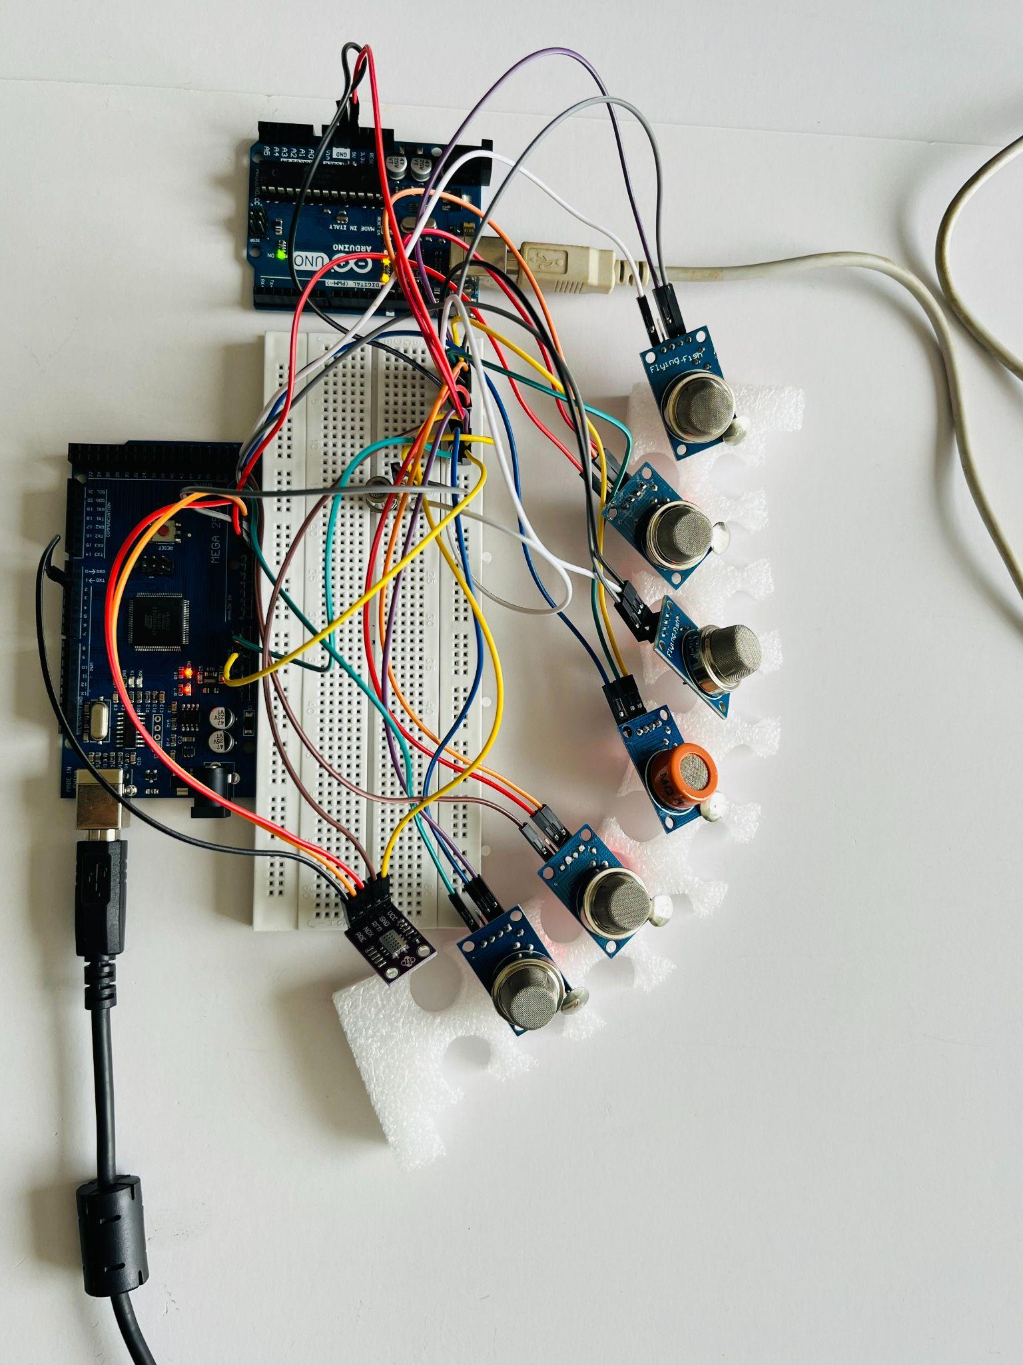
Receiver Setup

Slide 16
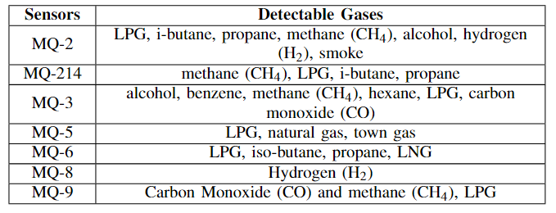
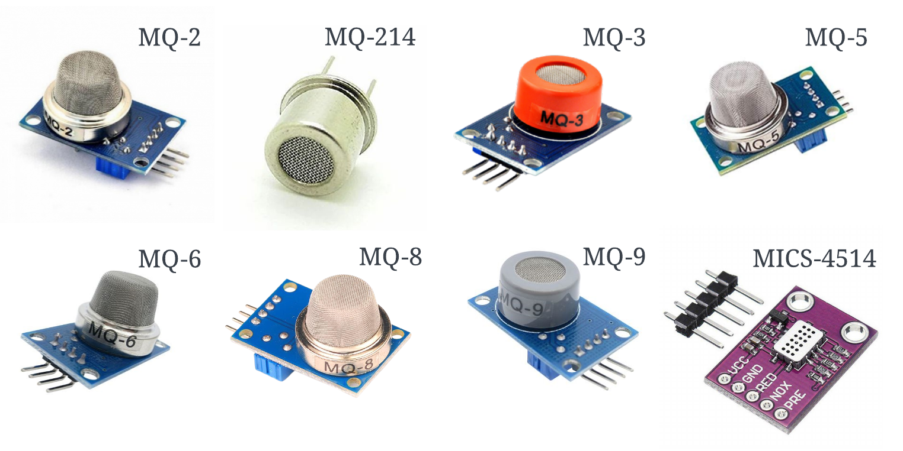
Sensors
Thinner : toluene, acetone, butyl acetate, ethyl acetate, and alcohols like isopropyl alcohol or ethanol

Slide 17
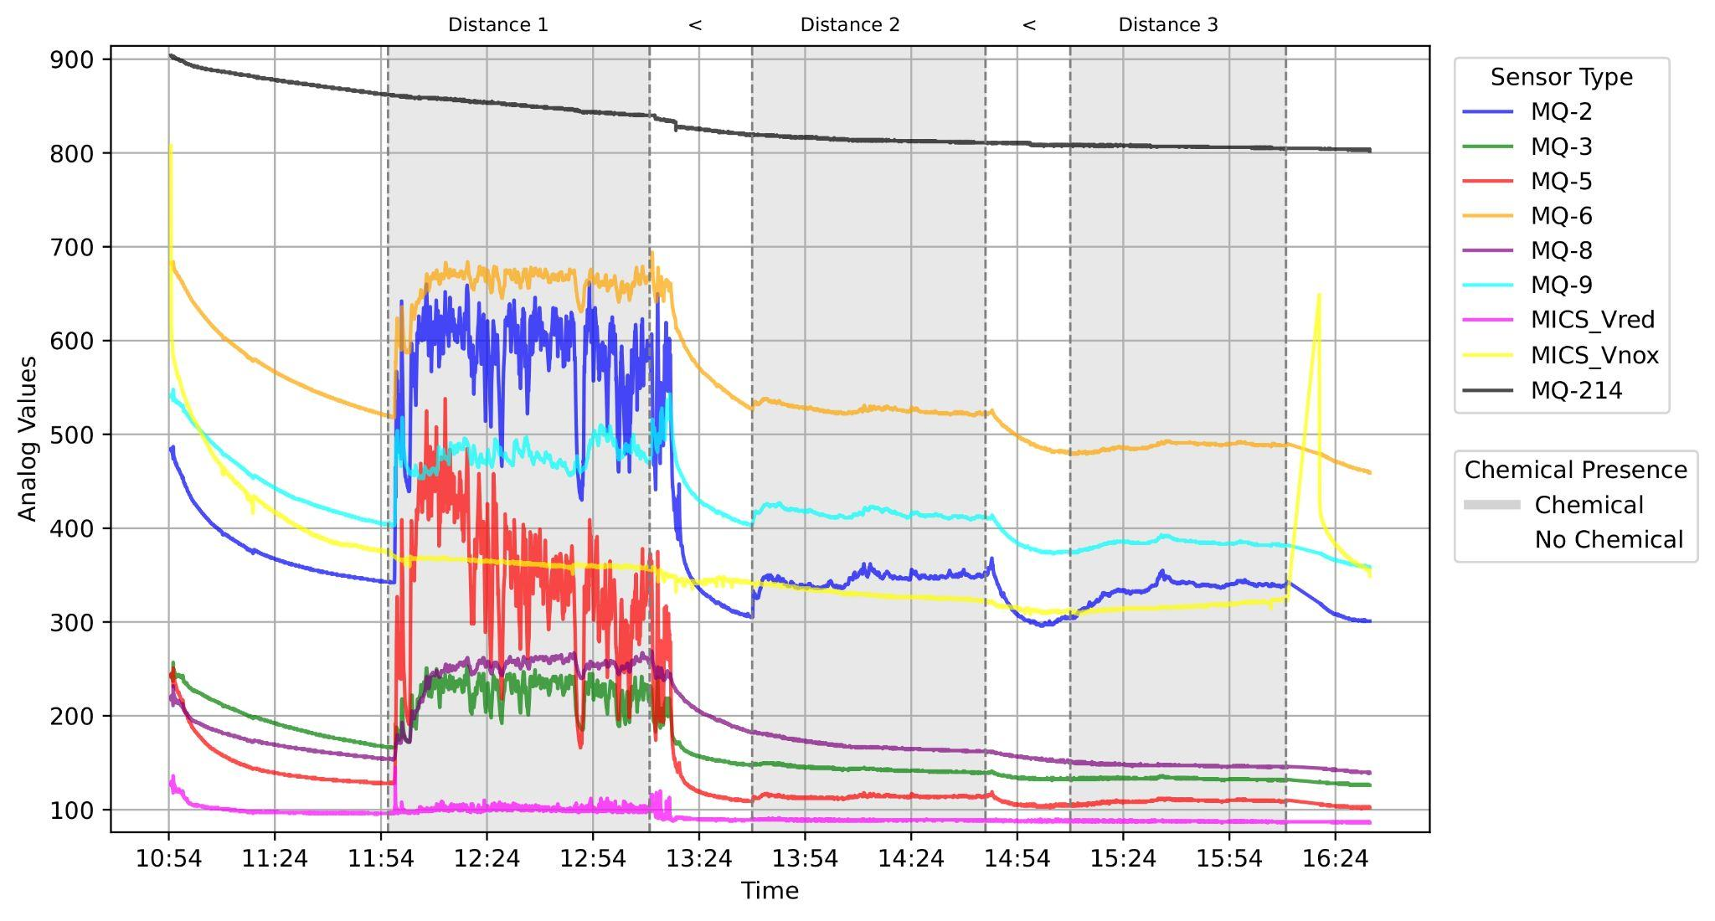
Sensitivity of Gas Sensors (Hourly Intervals)
Readings taken hourly with and without Ethanol exposure.
Distances: 30 cm, 60 cm, 120 cm.
MQ-2, MQ-6, and MQ-9 show strong sensitivity at longer distances.

Slide 18
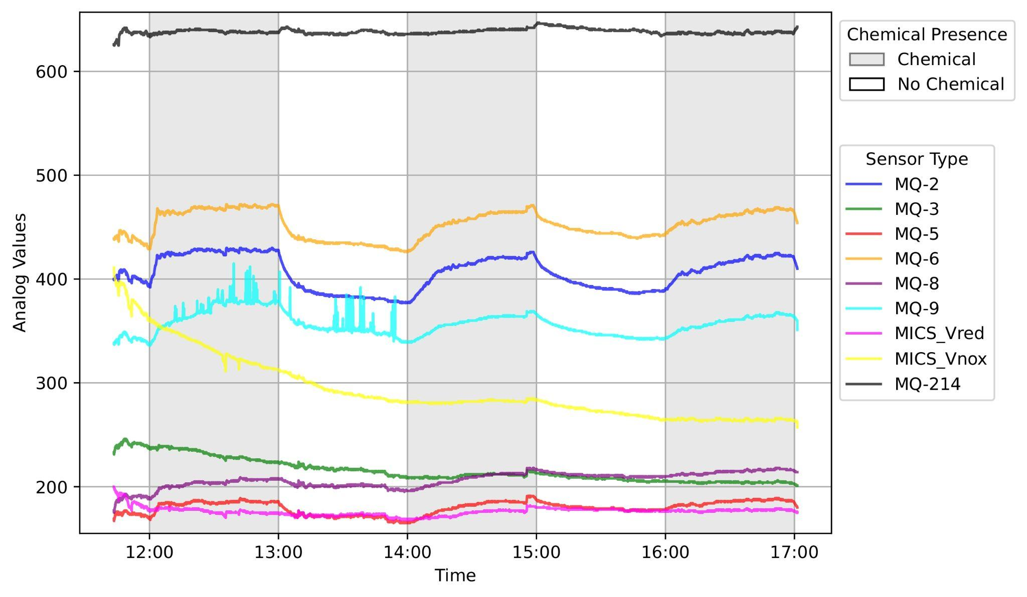
Slow-rate Data Transmission (Hourly Intervals)
Readings taken hourly, capturing an alternating pattern of 1s and 0s using Ethanol.
Distance: 120 cm
MQ-2, MQ-6, and MQ-9 demonstrate consistent sensitivity.

Slide 19
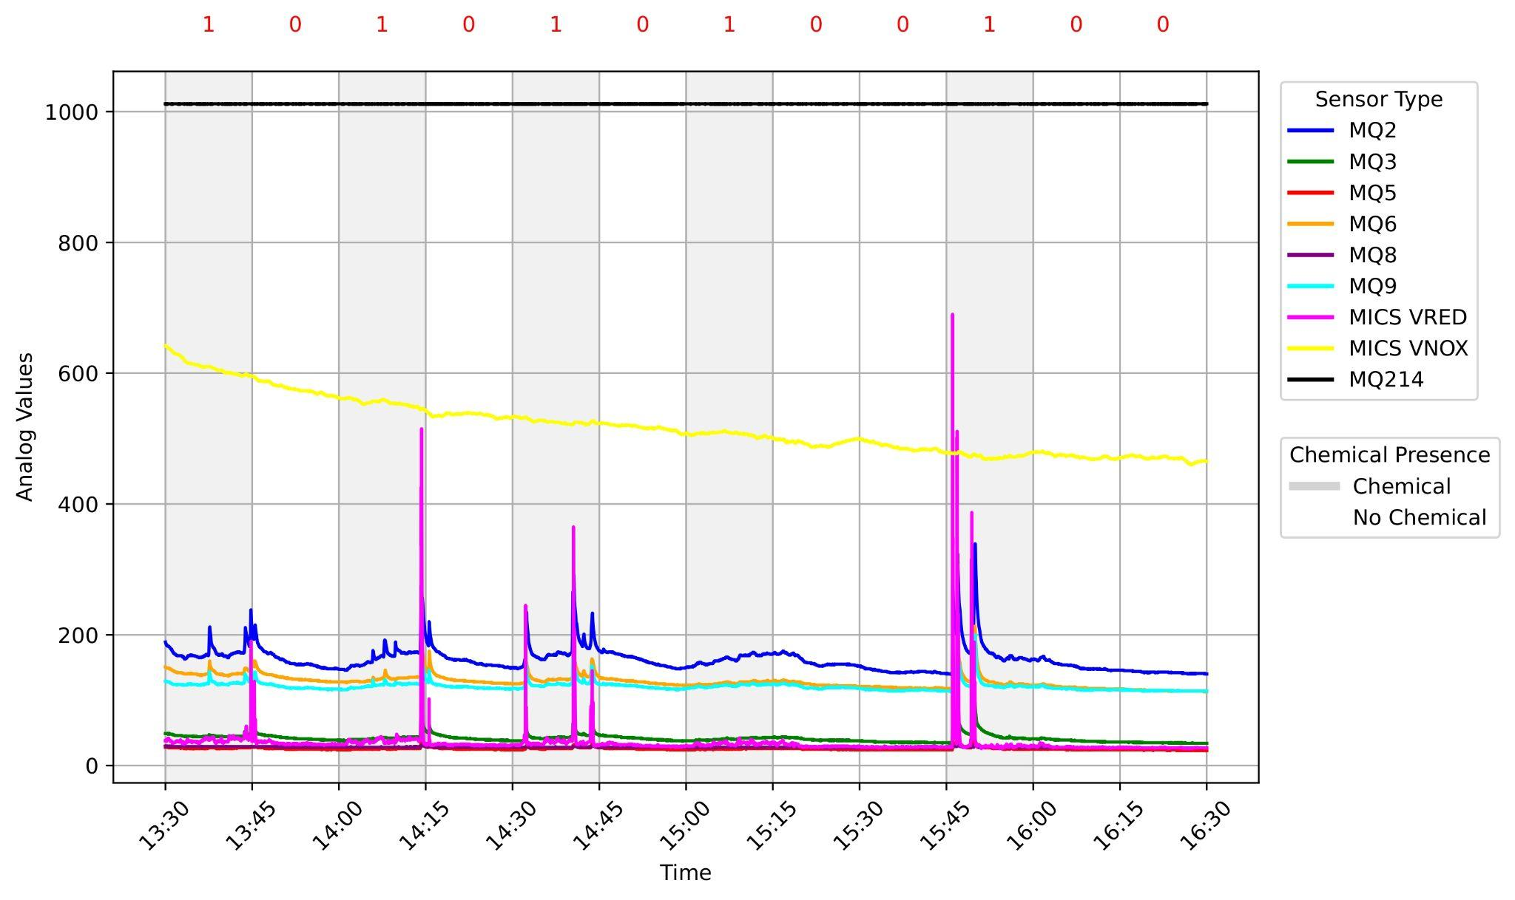
Fast-rate Data Transmission (15 Mins Intervals)
Original bit pattern:
10101010
Hamming(12, 8) coding scheme:
101010100100
Readings when transmitting Hamming-encoded data using Thinner.
Distance: 120 cm
MQ-9 demonstrates impressive results.

Slide 20
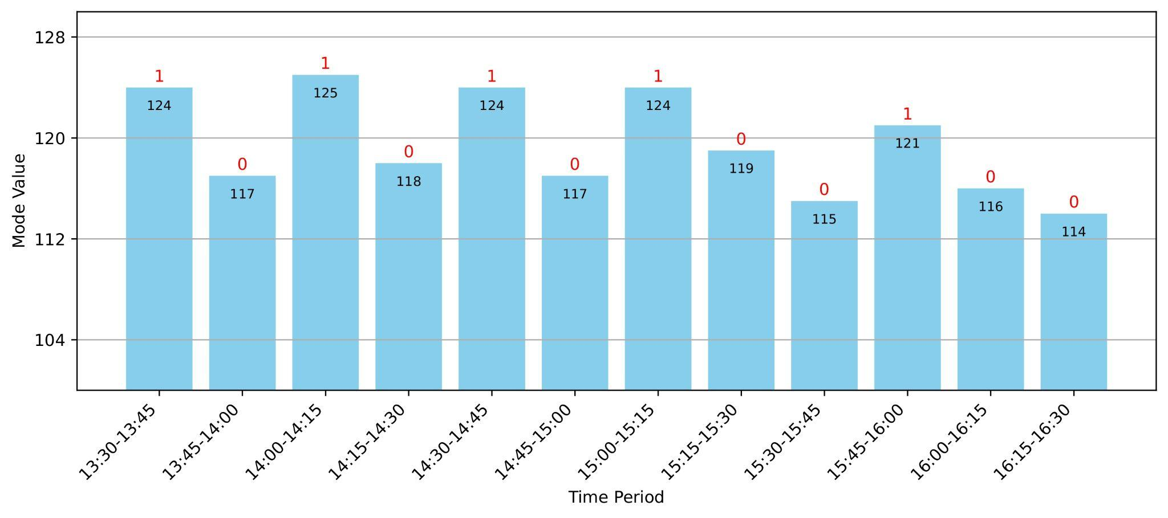
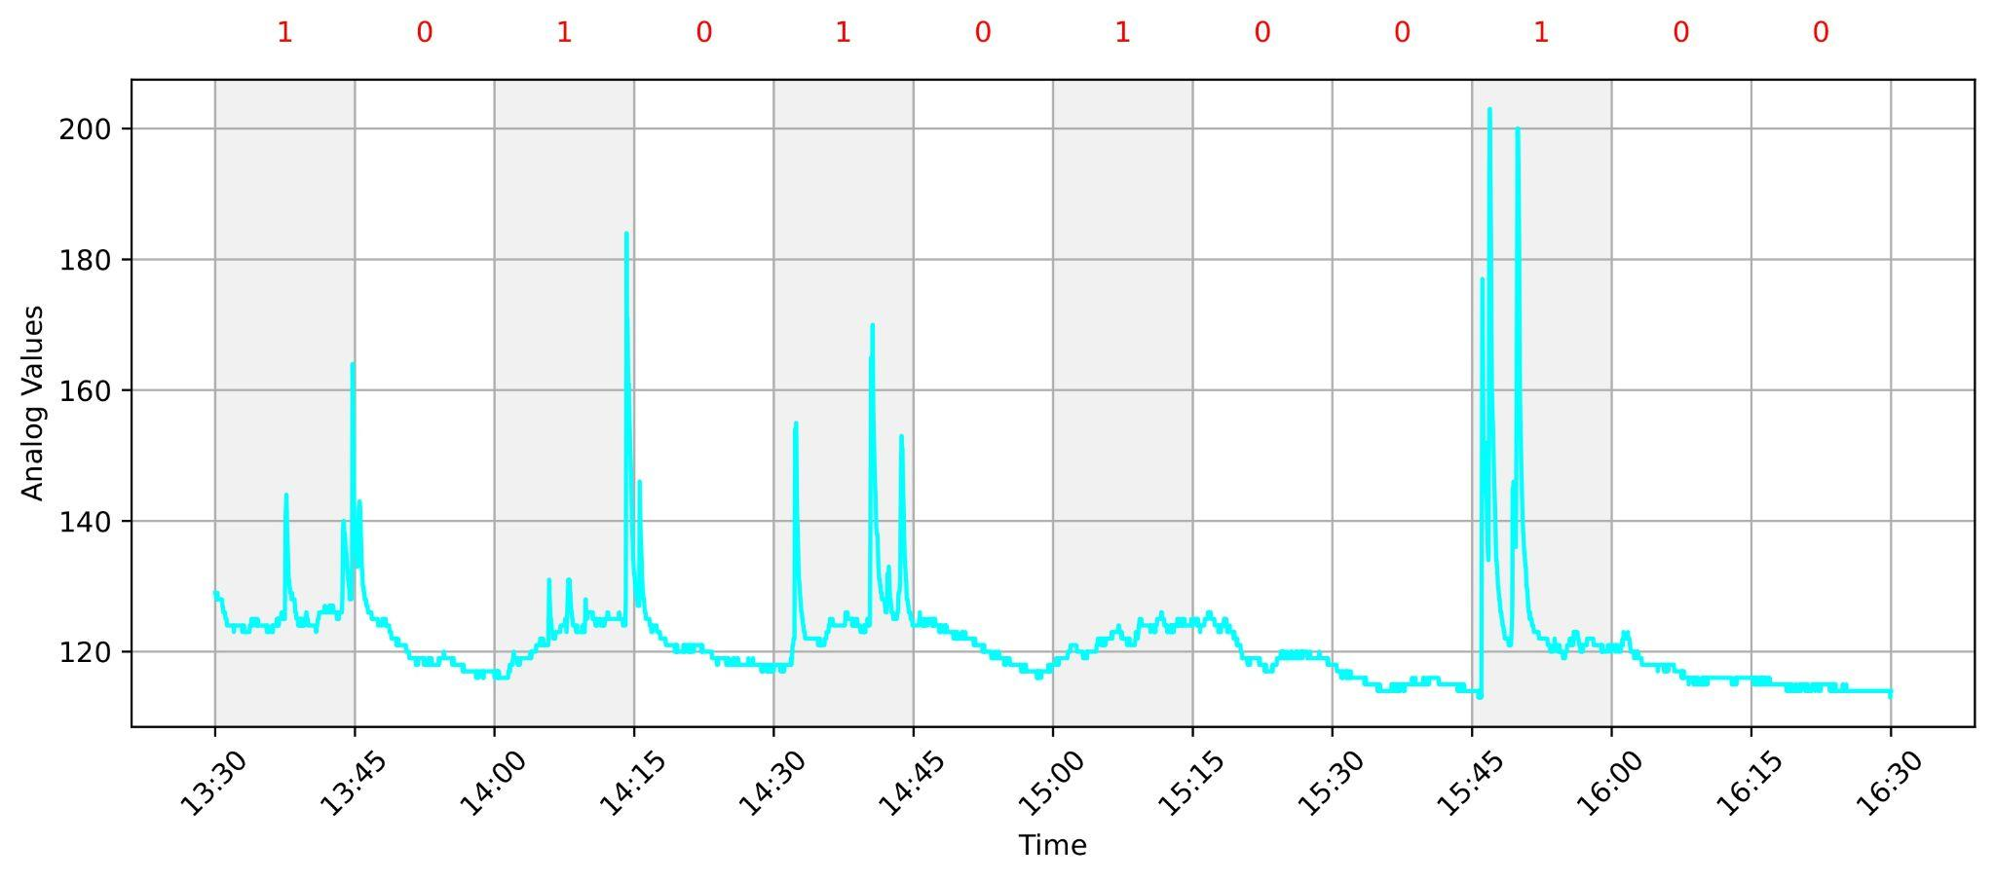
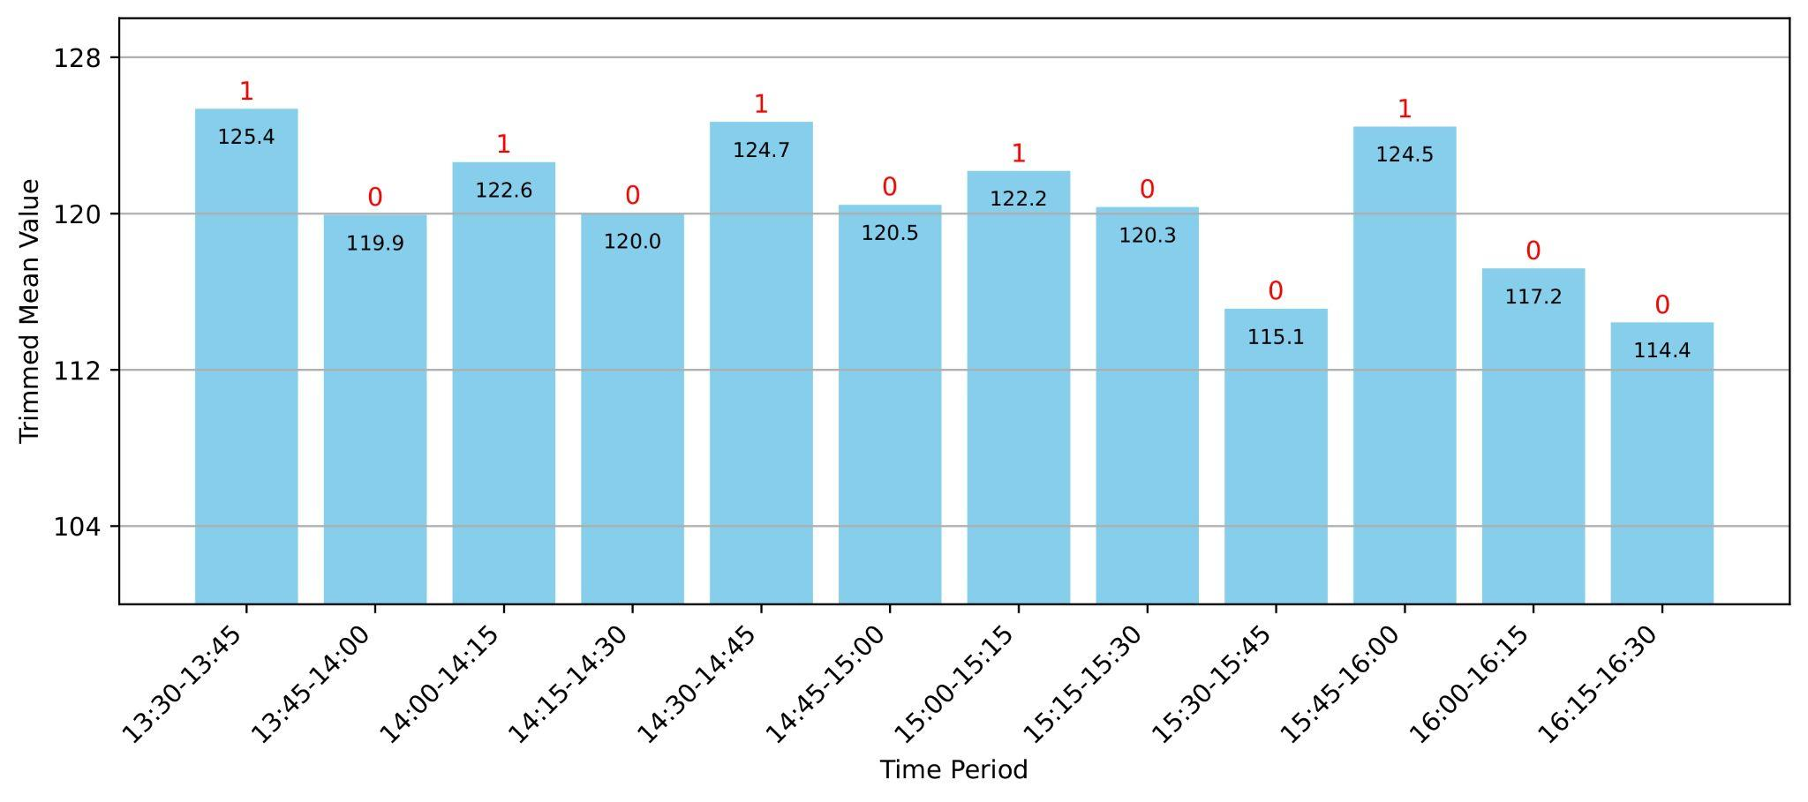
MQ-9 Fast-rate Data Transmission (15 Mins Intervals)

Slide 21
04
Future Work

Slide 22
Log environmental factors (temperature, humidity) to assess their impact on sensor readings and transmission.
Current approach: compare sensor outputs with and without chemicals, focusing on fluctuations.
Need to establish a threshold or baseline value for each sensor for greater accuracy (sensor readings vary and don't start at zero).
Plan to develop a portable setup for easy transport across environments.

Slide 23


Slide 24
Summary!
MC is an alternative to electromagnetic communication in noisy or obstructed environments.
MC requires specialized hardware and chemistry expertise, complicating research.
We developed a cost-effective platform using inexpensive sensors and common chemicals (Ethanol, Thinner).
Free diffusion is used for signal propagation.
Experiments successfully transmitted binary and Hamming-encoded data.
Results showed accurate reception in real-world conditions at room temperature.

